Slide 1
How We Deliver Day 2 Capgemini America Inc. Financial Services Strategic Business Unit
June 2019 v3.3
PLEASE WATCH AS A SLIDE SHOW

Slide 2


Session Map
Group Fundamentals
Roles, Tools, Accelerators
References
Engagement Management (EM) Learning Journey
Methods
1
2
3
4
5

Slide 3

Objectives
This module will help you be aware of:
Capgemini Group Fundamentals and know where to find your key aids for Engagement Management
Key Engagement Management methods and why they are used
Unified Project Management, Capgemini’s project management method
Tools and accelerators that help us drive successful delivery of our projects.
Tips for success

Slide 4
Delivery is the proof of our pudding
Operational
This challenging goal calls for a homogeneous and continuously improving delivery capability.
Strategic
Our core business is to deliver high quality solutions transnationally.
Financial
Clients delight at profit, with high Contribution Margins (CM) and Delivery Value Improvement (DVI) keeps us winning in the Champions League!
Notes:
Stress how people power all these dimensions and help us be more competitive.

Slide 5
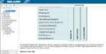
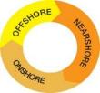
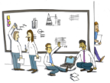
What Do Our Clients Expect from Delivery?
Combined project teams
Capgemini provides
Consistent methods, tools and enablers
Open
communication
Our Consistent Methods: DELIVER
Our Project
Management Platform
Knowledge Transfer
Trust and mutual respect
Our Rightshore® Model
Our Delivery Centers
Responsiveness
Explicit risk sharing
Rightshore® is a trademark belonging to Capgemini
Notes:
What else can you think of?

Slide 6
The basics…
Communication & Meetings
Notes:
Focus on Clients and People
When we put our clients and our people at the center, we are then serving a purpose larger than ourselves
Real Teams form and solidify
Dynamic, fast-paced, vibrant culture ensues…
Results Follow
The Organization will Thrive

Slide 7
Methods of Communication
Email
Keep the big picture in mind
Ensure your message is Clear, Concise, Correct and Complete
Know your audience
Message = Needs of both parties
Always Maintain Professionalism
On the Phone
In Person
Notes:
Key Point:
There are common practices to keep in mind regardless of the method of communication
Be sure to plan your communication before you take action
On any project, it is important to establish the preferred method of communication to clients, teams, Project Managers, and other stakeholders

Slide 8
Participating in Meetings
Roles for running a meeting
1. Owner
Meeting Types
Kick-off
Project coordination
Program Update
Close-out
Briefing
Coaching
Brainstorming sessions
2. Facilitator
3. Resources/
Team Member
Additional roles:
Time keeper
Meeting minutes recorder
Scribe
Notes:
Introduction:
Meetings can be a fantastic way of doing business collaboratively, or they can be a waste of everyone’s time.
Establishing roles for a meeting can help focus the session so that it is valuable for all attendees
Depending on the setting (business or external) the roles may differ
Key Point:
What are some tasks that #3 Team Members can do in the meeting?
Why are meeting minutes important?
Be aware of numbers and seniority (maintain a balance between clients and Capgemini in a room)

Slide 9
Meeting Roles
Owner
Facilitator
Resources/
Team Member
Additional
Roles
Owns” the meeting – sets the objectives
Helps determine the participants
Provides support, information and resources
Sets the tone
Encourages participation and creativity
Demands serious preparation, attention and effort
Sets high – but reasonable, achievable expectations
Is the ultimate decision maker!
Owns the meeting “process”
Ultimately responsibility for the meeting’s success
Headlines and clarifies ideas
Aids team performance
Records group ideas and decisions
Makes it “safe” for everyone to participate
Monitors time contract
Brings team back on-track when needed
Remains objective at all times!
Comes prepared
Generates ideas and recommendations
Adheres to the agenda
Practices good meeting behaviors
Completes assigned tasks
Participates actively
Time Keeper
Keeps meeting on track
Scribe
Accurately and neatly captures “group think”
Meeting Minutes Recorder
Accurately captures key inputs, issues and decisions generated during the meeting
Distributes meeting minutes to the team members after the meeting to ensure validation from team members

Slide 10
Meeting Dos and Don’ts
DO
DON’T
Participate openly
Focus on the problem, not the person
Listen actively to what others have to say
Rephrase and summarize contributions
Take a "how to do it" rather than "why do it" attitude
Be positive… no idea is a bad idea
Headline issues
Build on others' ideas
Stick to the agenda and to time contract
One meeting at a time
Make it enjoyable for everyone
Come with a ‘hidden agenda’
Have side conversations or meetings
Ramble
Lob grenades or launch missiles
Look for the "fatal flaw"
Violate time contracts
Drag participants into "lose-lose” situations

Slide 11
Meeting Hints and Tips
Hints and tips
Be yourself, but keep up your consulting guard at all times
Review the setting and ensure discretion - it is not wise to have a confidential conversation in the middle of a crowd
Be aware of your body language
Develop a highly tuned ability to balance business and social conversation
Maintain your consulting guard at all times
Notes:
Key Point:
When you are in a face-to-face situation, it is important to be flexible and adjust to your audience
Be aware of your surroundings

Slide 12
Capgemini Consulting Guard

Slide 13
Who is a Consultant?
A consultant is a person in a position to have some influence over an individual, group, department, or organization, but who has no direct power to make changes or implement programs.
Problem Solve: Analyze business issues and quickly understand such information
Advise: Apply specialist skills and knowledge to accelerate problem definition and solution development
Provide Customer Service: Managing expectations, honestly communicate project experiences effectively and build client relationships
Deliver Excellence
Notes:
Key Points:
Approach every situation as an opportunity to sell yourself
Remain professional in all engagements with a client
Consultants need to always “add value”

Slide 14
At the Client Site – Always wear your Consulting Guard
How
What
Values & Behaviors: what we believe and how we demonstrate it
Ways of Working: what we do and how we do it
Preserve client confidentiality and anonymity
Do not mention other clients by name
Attend meetings on time and prepared
Take accountability for a fair share of next steps
Ensure next steps done well and on time
Why
Deliver results with utmost professionalism
Create and sustain trust and positive impressions of you and our company at all times
Fulfill obligations regarding confidentiality
Demonstrate impartiality and honesty
Give credit for the ideas and the efforts of others
Maintain enthusiasm and a positive ‘can do’ attitude
Use discretion and judgment in personal relationships
Avoid involvement in gossip – treat everyone with respect
Notes:
Introduction:
Introduce “the Consulting Guard”
Key Points”
As a Consultant you represent the quality of Capgemini as a whole
Be cautious at all times
Don’t speak negatively about Capgemini, current/prior clients, or co-workers
Key Points:
Re-enforce professionalism

Slide 15
Group Fundamentals

Slide 16
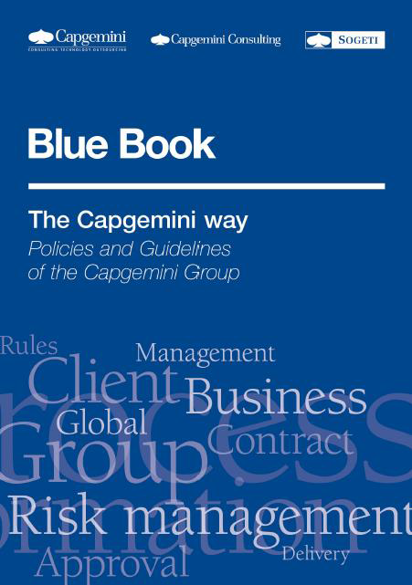
Group Fundamentals
Across Capgemini Group, various sources of information address delivery policies and guidance in general.
The diagram shows the interrelation between these guides and the Corporate methods DELIVER, UPM (Unified Project Management) and overall policy document, The Blue Book.
Policy
Local Quality Systems
Methods
Guidance Elements (i.e. DELIVER)
UPM V6
Principles
Rightshore Manuals
Delivery Rule Book
EM Handbook

Slide 17
The Blue Book
Difference between the revenue invoiced and paid by the client and the total costs to deliver.
** DVI: difference between delivered contribution and budgeted contribution
The Blue Book documents Capgemini’s Policies and Guidelines.
All employees must be familiar with the adopted principles, values, policies and processes, and actively adopt and comply with them.
Chapter 10, Delivery, is composed of 13 specific sections that address all of the topics related to delivery.
Delivering a Project has 4 Objectives:
Optimal End-to-End Contribution* for Capgemini aiming for the generation of a positive Delivery Value Improvement**



Delivery of our contractual obligations as agreed with the client
Client satisfaction
Generate add-on sales
https://talent.capgemini.com/global/pages/about_us/our_group/ethicsandcompliance/policies__guidelines/policies/blue_book_intro/

Slide 18
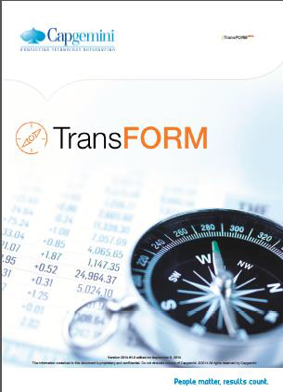
TransFORM
Purpose
TransFORM is the reference document for Group Finance. Topics include:
Key Content
Chapter 2: Operating Rules & Key Controls
Chapter 3: Bookings & Funnel
Chapter 4: Project & Deal Accounting Rules
Chapter 8: Key Performance Indicators (KPI’s)
Will help you to:
Understand how to optimize the End-to-End Contribution of our engagements
Monitor and increase DVI

Slide 19
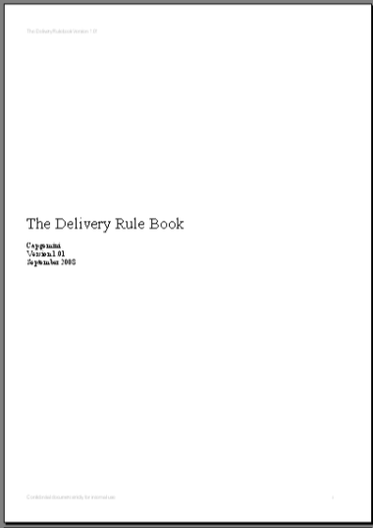
Delivery Rule Book
Purpose
Defines the ‘Capgemini Way’ of engagement delivery for project and service type engagements.
Explains the engagement mandatory requirements and the delivery responsibilities.
Key Content
Roles and Responsibilities in Engagement Delivery
Sales to Delivery Handover
Organizing the Engagement Start-Up Phase
The Steering Boards
Evaluating Client Satisfaction
Engagement Tracking and Reporting
Engagement Close-Down
Mandatory Deliverables for Project-Type Engagements

Slide 20

EM Handbook
Purpose
The EM Handbook defines the Capgemini way of managing projects.
Provides guidance by stream in terms of what an EM needs to be doing in their day to day life
Key Content
Explains step by step, day in the life of an Engagement Manager.
Aligns to all Group principles and walks a PM through the various activity and events as outlined in UPM in terms of managing a project from start to finish
Be sure to refer to local UPM (FS) to see the standard templates for your region and standard financial tools.
Structured by Stream

Slide 21

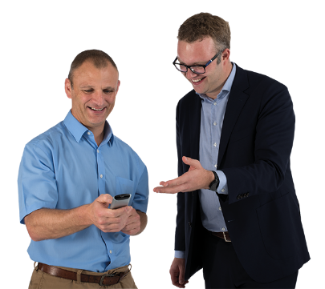
Let’s Break Into Teams
It’s time for an exercise

Slide 22
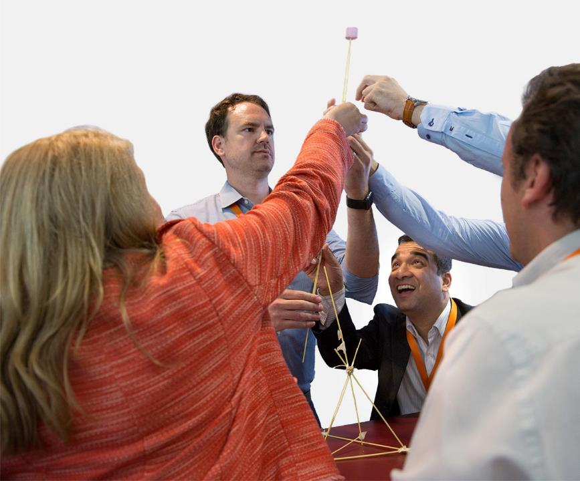
Objective
Construct the tallest freestanding structure with the provided materials.
Instructions
With the people at your table, take 15 minutes to:
Create the tallest tower using only spaghetti, tape, string, marshmallow.
The marshmallow needs to be on top.
Notes:
25 Minute Exercise
Agenda:
Introduction – 5mins
Building Session – 15mins
Debrief Session (all) – 5mins:
Reference the Four Stages of Behavior (forming, storming, norming, performing) and ask each team what stage they are now after completing the exercise
Conclusion:
Different people played different roles on their team during the Exercises

Slide 23
Methods

Slide 24
DELIVER – Capgemini Global Methods Environment
our global quality and delivery system providing a common, consistent and transnational approach to selling, managing and delivering
provides frameworks, methods, techniques and tools for managing and delivering all types of programs, projects and services
covers our range of offerings, facilitating business development, architecture design, application development, package implementation, and support services
What is DELIVER?

Slide 25

DELIVER Methods in scope for EM
Unified Project Management (UPM) and iQ
Start Up
Execution
Close -
Down
Global Transition (GT)
Unified Service Management (USM)
Transition Handover In
Service Run
Transition Handover
Out
For FS specific methods: https://km3.capgemini.com/book/708503
Notes:
All should be aware of the differing methods – brief recap on what they are and used for and how they fit together

Slide 26

FSSBU Quality Management System (iQ)
1
8
Uses DELIVER 2.0 Methods as applicable
2
Flexible implementation Model through tailoring and deviation
Based on best practices from over 12 years of FS experience
Regular maintenance based on feedback received
Aligned to Rightshore
Model 3.0
7
3
Caters to
client requirements – Quality, Productivity, Security
Global Methods with Global Applicability
Compliant with CMMI V1.2 Level 5; ISO 9001:2008; ISO 27001:2005 and PCI DSS
6
4
5

Slide 27
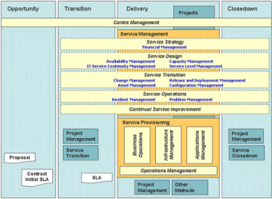
DELIVER: Engagement Management
Engagement Management
DELIVER Service Management
Strategy
Architecture
Design & Build
Outsourcing
Sales
DELIVER Programme Management
DELIVER Project Management
DESIGN
ESTABLISH
ACHIEVE
ASSESS
TRANSITION
Leadership and Communication
UNIFIED PROJECT MANAGEMENT
Business Benefits
Start - Up
Execution
Close - Down
Relationships
DELIVERY METHOD(S)
Resources
Architecture Design
Integration
Application Development
Governance
PJM5_005
Pgmo5

Slide 28
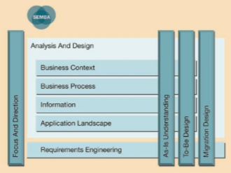
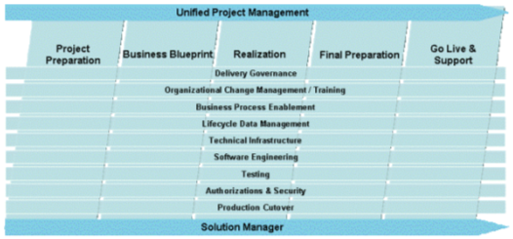
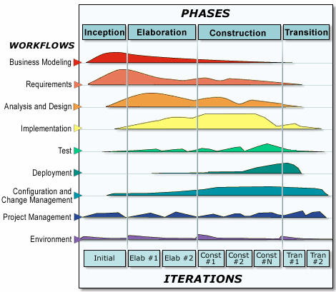
DELIVER: Delivery Processes
Engagement Management
Business
Analysis
Strategy
Architecture
Design & Build
Outsourcing
Sales
Rational Unified Process (Build)
SAP Standard Implementation

Slide 29
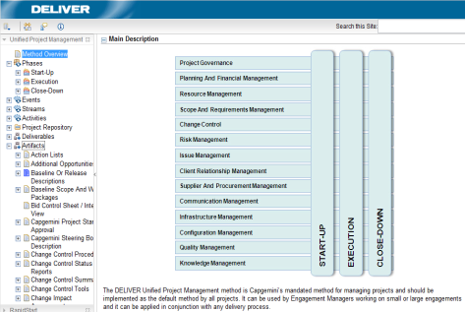
DELIVER: Unified Project Management (UPM) Method
Unified Project Management v6
Compatible PMI and PMBoK Ed. 5, CMMI v1.2, mapped to PRINCE2
Guidance, Templates structure
Tailoring rules at all levels (BU and project)
Deployment Method
Tailoring at BU level
Same structure and publishing
EPF support center
Collaterals
EM Handbook
eLearning
University trainings
Deployment accelerator: RapidStart

Slide 30
UPM helps address the reasons for Engagement Failure
Roles and
Responsibilities
Unclear
Lack of User
Involvement
High level
or vague
Requirements
Scope Creep
Failure to
Manage
Change
Inexperienced/
Untrained EM’s
Inadequate
Communication
Long or
unrealistic
timescales
Poor Testing
Poor effort and
timescale
estimation
Incorrect
Resources
Failure to set
and manage
expectations
Poor
understanding
of project
objectives
Poor
Planning

Slide 31
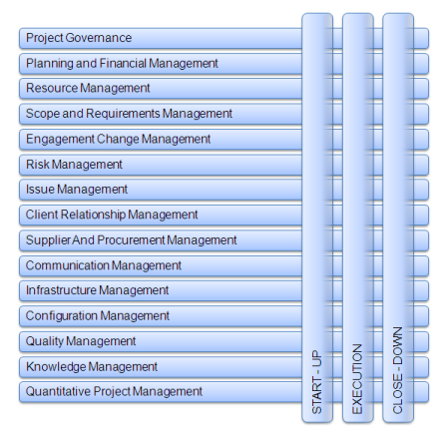
UPM (FS SBU) Streams and Phases
Notes:
Spend a minute to highlight tailoring wrt FS SBU UPM (addition of QPM etc). Clarify streams and phases (there will be college hires as well).

Slide 32

Refining the Project Approach
How will the project be governed?
Organization, roles and responsibilities
Reporting, internal and external
How will we work with the Client?
How will the delivery of the solution be achieved?
Requirements gathering
Development Approach
Work location – On Shore/ Offshore / Client
Approach to testing
Implementation into Live operation and ongoing Support
How will the project be managed?
Methods and Processes to be followed
Quality Management
Management of Suppliers

Slide 33

Defining the project approach is focused on how the project is going to be set up and managed and controlled
The engagement approach is focused on
‘HOW’ we will deliver.
Input
Output
Sales Process
Start-Up
Project Governance Plan (PGP)
Determines high level project approach
Drives estimates
Sets the budget
Drives contractual terms
Review and refine the proposed project approach
Ensure final delivery approach aligns to contractual commitments, project budget and methods
Documents the Project Approach
Reviewed and signed by the client
If required by Client (contract) create document in their equivalent (eg: PID, SQP) and reference from the PGP
‘WHAT’ we will deliver is defined in the contract.

Slide 34
Every Engagement will use Two Methods
Programme Management
1. UPM - Project Management Method
Start-Up
Execution
Close-Down
2. Technology/Delivery Methods
Capgemini Agile Framework*
Data Migration
IDF
iSAP
SEMBA
RUP
Outsourcing Processes
Oracle Unified Method
Global BI
Global Transition
Note: UPM is the management method regardless of any management activities in technology methods.
Notes:
Mention we have an Agile QA framework and workbench that will be included in Technology Delivery Methods.
*CAF will now be renamed Agile Lift-off.

Slide 35
UPM: Phases and Events
End Of
Week
End Of
Month
Engagement Manager Invited
Final Acceptance Required
START-UP
Start Of Delivery
Phase Or Iteration
End Of Delivery
Phase Or Iteration
Engagement
Manager Committed
EXECUTION
Project Completion
CLOSE-DOWN
Team Members Arrival
Team
Member
Change
Project Team Members
Required
Project Issue
Identified
Project
Change
Identified
Procurement
Items Required
Deliverable
Completed
Project Compliance
Check, Review Or
Audit Required
Suppliers Required
Suppliers Required
Procurement
Items Required
Team Members Arrival
Supplier Audit
Or Review
Required
Supplier Delivery
Or Procurement
Item Received
Start-Up Activities Completed
Invoices
Raised

Slide 36

Tips for Success
Ask for help and do not reinvent the wheel.
Ensure you get the support you need.
Look in the Capgemini Engagement Manager’s Handbook.
Look in the Capgemini knowledge repositories for lessons learned on similar engagements.
Get active Client and teams’ buy-in.
Involve the Offshore Engagement Manager.
Look for delivery support assets for FS SBU.

Slide 37
Roles, Tools & Accelerators

Slide 38
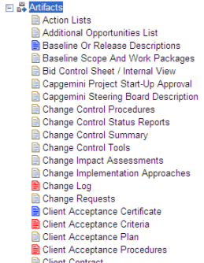
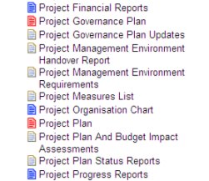
UPM: Artifacts
Mandatory artifacts (red icons)
Artifacts without which any project is considered in a totally unacceptable situation
Highly recommended artifacts (blue icons)
Artifacts without which any project of a reasonable size can probably not be managed in an effective way
. . . . . . . . . . . . . .

Slide 39
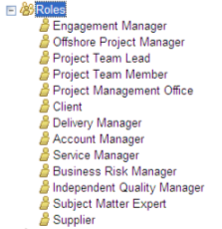
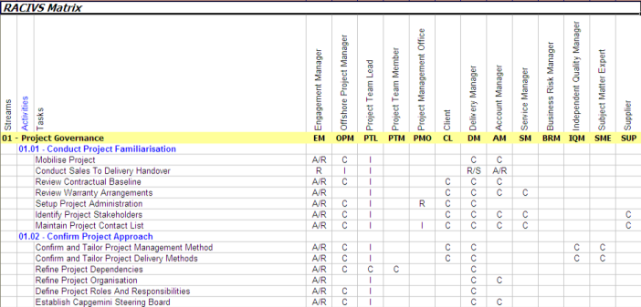



UPM: Roles and Tools
Integration of references to Group tools
OpenWorkbench

Slide 40
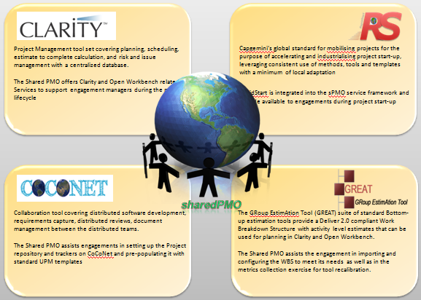
Accelerators Rapid Start / Close and Tools

Slide 41
DVI
“Delivery Value Improvement” –a KPI associated with how well our projects are delivered vs. how they were sold
Estimate to Complete provided by the field and uploaded into Need 2 Know (N2K, Finance tool for EM)
Calculated monthly based upon the Estimate at Complete (EAC), and Target/Budgeted Values
Estimate at Completion (EAC) is the addition of the ETD Actuals + RTBD
Original Budget should reflect the original signed contracts and all signed change orders rolled into the engagement code
Reported in terms of $:0 or positive is good, negative is bad
Actuals as they appear on the month-end WIP
Not the same as an overrun (write-off)
© 2017 Capgemini. All rights reserved.
41
© Capgemini 2017. All rights reserved |
41

Slide 42
What influences DVI
All things that affect CM%:
Receiving timely and realistic ETC from the engagement teams, and having that data available in Oracle
Timing adjustments of accounting transactions (i.e., month end accruals for contractors or affiliate resources, etc.)
Write-ups and write-offs recorded in the current month
Approved change orders which are included in the ETC and Actuals, but are not reflected in the Original Budget
Whether or not the Original CM included performance/milestone event
Pass-through expenses
Ability to collect more/less than originally planned
Staffing better or worse than originally planned

Slide 43
Actions to improve DVI
Read the SOW to know the scope, responsibilities, and assumptions for us and the client.
Don’t do work for free. Bill all your time working on the project.
Build quality in every step. It is much less expensive to build quality from the start than to address issues after the fact.
Don’t do work for free. Issue change orders for incremental scope.
Manage to the planned allocation of hours for each task and stream
Escalate potential issues very early –“bad news doesn’t get better with time”
On fixed-fee projects shift work to lower cost productive staff, offshore or junior resources

Slide 44
Billable vs. Non-billable Time (NBT)
Regardless of the Billable hours, always account for your total hours
worked
9 / 8 Hours per day are Billable to the client based on the contract. In general, 9 hours are the norm however, some contracts incorporate 8 hour days.
This means, if you actually work 15 hours daily, you can “Bill” 9 / 8 to the client, coding those hours to your projects BILLABLE Code.
The remaining 6 hours should be coded to the projects NBT code.
Not accounting for these hours is called “Ghosting Hours”.
Ghosting Hours impacts the project and YOU personally.
Eliminates potential sales for the account
Impacts future estimates, as actual time to complete work is not known.
Leads to employee burnout & turnover
Does NOT contribute to your Utilization Target
Please see your EM/Staffing Partner if you can not locate the appropriate NBT code

Slide 45
Contribution Margin Improvement (CMI) Incentive Bonus Program
If you can improve the profitability of your engagement, you could be eligible for an incentive bonus.
Since 2010, more than 1,950 people from 250 teams have received incentive bonuses totalling more than €2,300,000.
For responsible engagements, the incentive bonus can be up to 20% of the contribution margin improvement. For non-responsible (staff augmentation) engagements, the incentive bonus can be up to 10% of the contribution margin improvement.
Details of the program and the application form can be found in KM 3.0 at: http://km3.capgemini.com/book/405286
Submit your application today to take advantage of this win-win-win opportunity for your team, FS SBU, and Capgemini.
Notes:
In 2010, the FS GBU implemented a Delivery Value Improvement (DVI) Incentive Bonus Program (renamed to Contribution Margin Improvement (CMI) incentive bonus program in 2013). The intent of the program was to provide an incentive bonus for our Delivery teams to improve the actual delivered contribution margin percentage from the contribution margin percentage approved at the time of the sale of the engagement.

Slide 46
Engagement Management Learning Journey

Slide 47
EM Practitioners Course
Day 1
Day 2
Day 3
Day 4
Day 5
Introduction
Creating the plan
Day to Day management
Monthly status reporting
Project Close Phase
Sales to Delivery transition
Client Relationship management
Legal considerations
Managing change
Steering Board
Defining the approach
Project management processes
Client reporting
Cultural awareness
Conversations with the Executive delivery
Client kick off and on-boarding
Finale
Engagement financial overview
Soft skills
Determining the project organisation
Session wrap up and close
Other start up items and close our of the phase
Monthly status reporting and steering board
Team preparation

Slide 48
References

Slide 49
References
iQ
https://e-3d.capgemini.com/sites/SSC2/QMS2/SitePages/QMS.aspx
KM3.0
Pre-learning for EM Training
Delivery Excellence: https://km3.capgemini.com/community/317108/home
EM community: https://km3.capgemini.com/community/20102/home
https://km3.capgemini.com/book/338955
EM Calendar: https://km3.capgemini.com/book/1071453

